Slide 1



DESAFIO 1 - MAPAS
View in Power BI
Last data refresh:
9/15/2025 5:23:24 AM UTC
Downloaded at:
9/15/2025 5:27:27 AM UTC

Slide 2
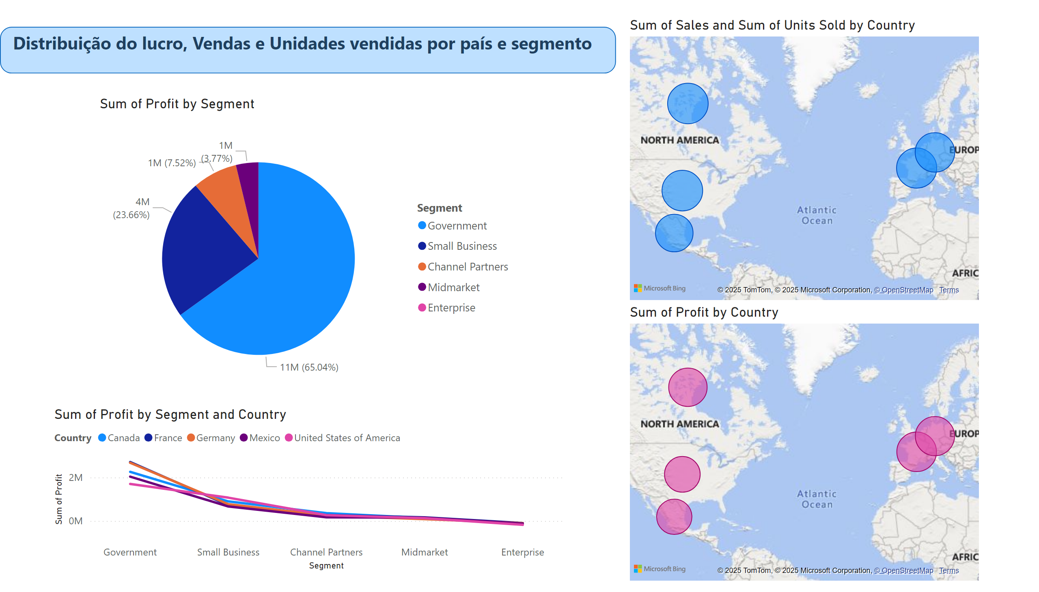
Página 1
Notes:
map
No alt text provided
map
No alt text provided
pieChart
No alt text provided
lineChart
No alt text provided
textbox
No alt text provided
shape
No alt text provided

